Slide 1

School of Social Work
Field Instructor Orientation
Courage. Compassion. Competence.
www.uakron.edu/socialwork/

Slide 2
Mission Statement- Graduate
To prepare students to engage in advanced professional practice with and on behalf of diverse populations in Northeast Ohio with emphasis on the health, well-being, and quality of life of oppressed and vulnerable people.
We promote the dignity and worth of the person, human diversity, cultural competence, and social and economic justice through scientific inquiry, creative activity, and service.
We advance the social work profession through collaboration with the community.
Courage. Compassion. Competence.

Slide 3
Mission Statement- Undergraduate
To prepare students for competent and effective generalist practice.
The School of Social Work is committed to empowerment and strengths-based practice through the application of critical thinking skills.
We engage the diverse populations of Northeast Ohio to strengthen systemic well-being.
Courage. Competence. Compassion.

Slide 4

Mission Statement - CHP
Courage. Competence.
Compassion.
The College of Health Professions improve life for individuals, families, and communities by providing health and wellness education with appropriate interventions and solutions that are inter- professional, innovative, and influential.
The College prepares students to advance human well- being and to thrive in a rapidly evolving global environment.

Slide 5
Mission Statement- UA
To ensure student success and leverage our region’s unique assets in the creation of knowledge and application of research that benefits humankind.
Courage. Competence. Compassion.

Slide 6
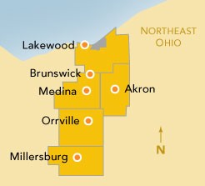
Field Placement Agencies
100 + organizations
18 counties
Ashland | Ashtabula | Carroll | Cuyahoga | Geauga | Guernsey | Holmes | Lake | Lorain | Mahoning | Medina | Portage | Richland | Stark | Summit | Trumbull | Tuscarawas | Wayne
School of Social Work locations: Akron | Lakewood | Stark | Wayne
Undergraduate & Graduate Programs

Slide 7
How do we achieve our mission?
Challenging course work preparing students for field education in preparation for a transformation into a professional social worker
Classroom with walls – critical thinking & Affective experiences
Knowledge
Comprehension
Application
Analysis
Synthesis
Evaluation
Bloom’s Taxonomy

Slide 9




Bloom's Taxonomv
Produce new or original work
Design, assemble, construct , conjecture , develop , fo rm ulate , auth or, investigate
evaluate
analyze
Justify a stand or decision
a ppraise, argu e, defen d, judge , select, su pport , value, critique , weigh
Draw connections among ideas
difforentiate , orga nize, relate , com pare, contrast , distinguish , exam in e, experim ent, qu estion , test
Use information in new situations
execute, im plement, solve, use, demonstra te, interpret , operate, schedule, sketch
apply
understand remember
Expla in ideas or concepts
classify , describ e, discuss , expla in , identify , locate , recognize , report , select , translate
Recall facts and basic concepts
defi ne, duplicate , list , mem orize, repeat , state
@cirtlmooc l@
The University of Akron - College of Health Professions

Slide 10
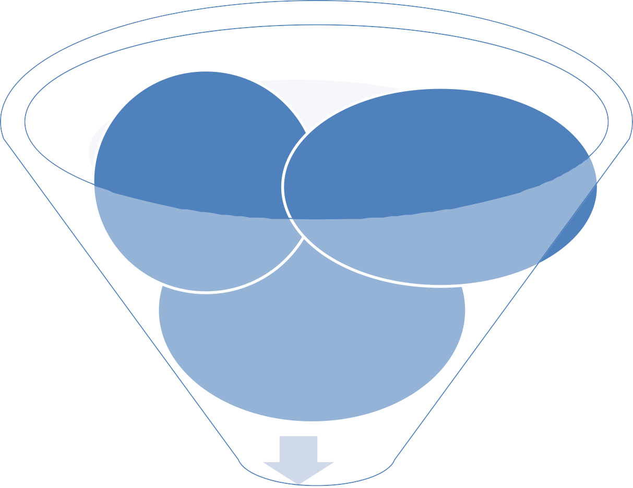
How do we achieve our mission?
Classroom without walls – Field Education – Field Placements
Courage
Compassion
Learn courage
Strengthen
compassion
Development/ Practice competencies
Competencies
Professional Social Worker

Slide 11
Field Education – Signature Pedagogy for Social Work Education
Field practicum is designed concurrently with classroom learning to provide experiential learning opportunities for application of social work theories and constructs, and development of the student’s professional sense of self.

Slide 12
Field Terms
Field Coordinator – university –based
Field Contact – university- based, faculty assigned to students at specific sites or in a program
Field Faculty Liaison – university-based, experienced practitioners in the community
Field = placement, practicum, internship, or clinical
Field Instructor – agency based with a degree in social work; provide social work
supervision
_{Task Supervisor- agency} School Director- university-
•
based, leadership of entire School of Social Work
based may or may not have a degree in social work; provide task monitoring

Slide 13


Starting Point…

Slide 14



Starting Point…

Slide 15


Do you remember your beginning?
What was difficult for you as a new intern?
What worked well for you?
How did you feel in the beginning?

Slide 16
Getting started
Student designated work space
Access to phone,
Walking tour of agency and overall introductions
computer, email, etc.✓ Schedule shadow
opportunities
Don’t underestimate
Explicit agency expectations: hours,
dress code, computer policies, specialized trainings, special functions
the importance of an orientation

Slide 17
Getting started
An approved scheduled for their 1st month with minimal deviation
Materials for independent review
i.e. policy & procedure manual, case records,
Emergency & safety- related procedures
Establish weekly meting time for supervision
Protocol when field instructor absence

Slide 18
Field Learning

Slide 19

Assessing your student
What does your student know?
What does your student think they know?
What does your student want to know?
What does your student need to know?

Slide 20
Assessing your student
How can others in your agency be a part of your student (s)
)educational journey?
How does your student learn best?
How do you teach best?

Slide 21


Describe how one hour supervision should look …for a social work student (intern).

Slide 22







Observe
Assess
Strengths
Developmental needs
Provide feedback in a timely, clear manner; explain the impact of behavior; set clear behavioral objectives that are tied to learning goals and/or professional standards and/or ethics
Conduct a minimum of two (2)
observable feedback sessions
Evaluate

Slide 23
Stages of the Field Instruction Process
Preparation, Orientation, Engagement
Assessment
Planning (developing Student Integrative Learning Contract)
Implementation (providing field instruction)
Feedback & Evaluation
Termination
Courage. Compassion. Competence.

Slide 24




Competent, ethical social worker who demonstrates knowledge & skills required to engage, assess, intervene, and evaluate practice with all client systems.
OUTCOME
WANTED

Slide 25
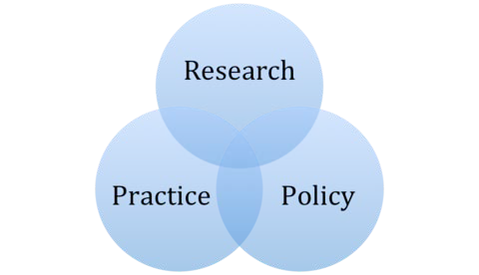
Literature support
Problem-based learning, Instructional theories, Learning theories, Supervision
Check web-site

Slide 26
Field Documentation –
Emerging professional

Slide 27

Documentation
Hours Log
Student- Learner
Observation
Narrative Log
Learning Activities & Evaluation

Slide 28
Documentation matters & there is help
GPS to Destination – Learning Activities & Evaluation tool
Template Blank
Practice | Observation- Hours & Narrative Logs
Template Blank
Assessment of Knowledge & Skills- Learning Activities & Evaluation tool
Template Blank

Slide 29
School of Social Work Website
www.uakron.edu/socialwork/
Field Education
https://www.uakron.edu/socialwork/field-education/

Slide 30
Field Instructor
https://www.uakron.edu/socialwork/field-education/
Social Work Student Organizations
https://www.uakron.edu/socialwork/student-organizations/

Slide 31
Questions – Ask your field contact person

